Slide 1
HSA Hardware Specification
Instructor: Yeh-Ching Chung
SSLAB

Slide 2
OutLine
Introduction
Heterogeneous System Architecture
Q & A

Slide 3
Intorduction
There are three specifications proposed by HSA foundation:
  HSA Platform System Architecture Specification
  HSA Programmers Reference Manual
  HSA Runtime

Slide 4
Traditional system with CPU and GPU
CPU
1
CPU
2
CPU
3
…
CPU
N
GPU
PCI-e
CPU memory(UMA)
GPU memory
For heavy compute bound process
Slow transition speed through PCI-e bus
Need advance programming skill

Slide 5
APU
CPU
1
CPU
2
CPU
3
CPU
N
BUS
…
GPU
CPU memory(UMA)
GPU memory
First time CPU and GPU in the same die.
The same physical memory address, but can’t be programmed.
More high transition speed, make GPU to execute more instruction.

Slide 6
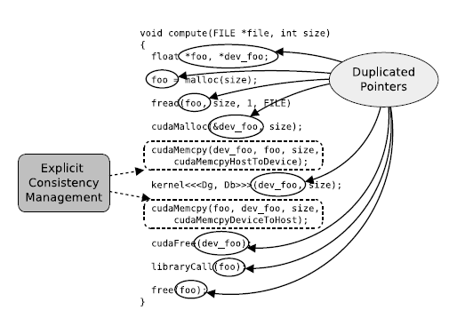
Heterogeneous Programming Issues
CUDA example

Slide 7
HSA
CPU
1
CPU
2
CPU
3
…
CPU
N
HCU
1
HCU
2
HCU
3
…
HCU
m
Heterogeneous Uniform Memory Access
UMA design can make all CUs access the same data.
Applications can choose favor CU.

Slide 8
Current Heterogeneous Programming Problem
OpenCL is more complicated.
Programmer need to prepare all the memory space before running.(can’t allocate memory in runtime)
Need to send kernel argument from agent to kernel clearly.
Need to write another kernel file to program the algorithm of kernel.
Programmer must aware a lot of detail.

Slide 9
Current Heterogeneous Programming Problem

Slide 10
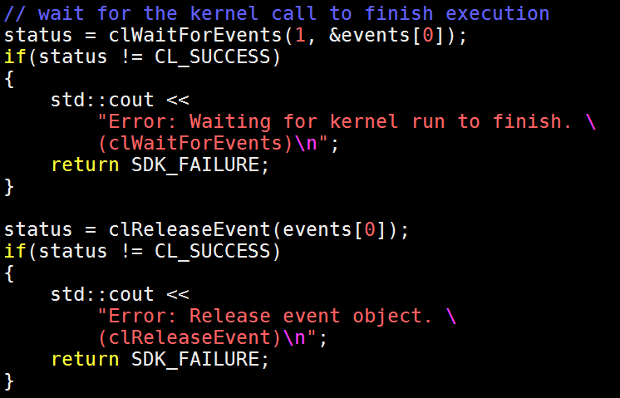
Current Heterogeneous Programming Problem

Slide 11
Current resolution
To build a more easy programming environment
Programmer don’t need to pay attention to the data movement
The hardware guaranteed the data movement.
Programmer can focus on how to generate their program much more

Slide 12
Table of Contents
Shared virtual memory
Cache coherency domains
Flat addressing
Endians
Signaling and synchronization
Atomic memory operation
HSA system timestamp
User mode queuing
Architected Queuing Language
Agent scheduling
Kernel agent context switching

Slide 13
Table of Contents(cont.)
IEEE754-2008 floating point exceptions
Kernel agent hardware debug infrastructure
HSA platform topology discovery
Images

Slide 14
Share virtual memory

Slide 15
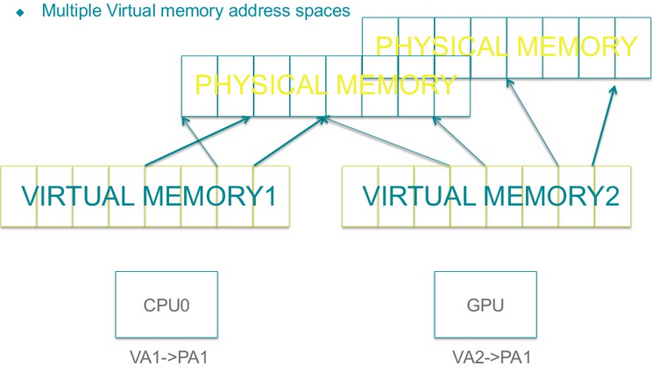
Shared Virtual Memory
Today:

Slide 16
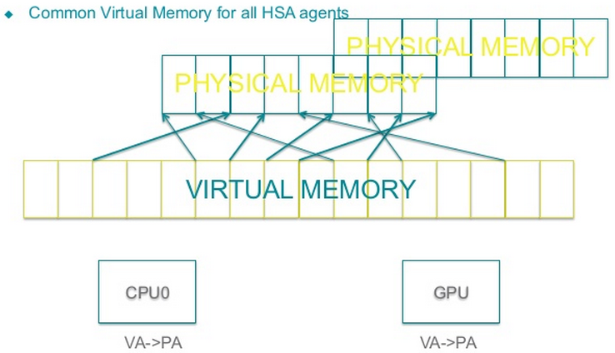
Shared Virtual Memory
HSA:

Slide 17
Shared Virtual Memory
Big machine model: 64 bits word
Small machine model: 32 bits word
Reserve ranges of the virtual address space for system internal use, e.g. private and group memory segments(explain in flat addressing).
The buffer which is used by program can allocate in shared memory or in the ranges you don’t want share.
Kernel Argument should allocate in shared part. Whatever you want to allocate in shared memory must through the HSA runtime memory allocator.

Slide 18
Shared Virtual Memory
System software is expected not to allocate pages for HSA application access in these non-shareable ranges.
System software is responsible for setting, maintaining, and invalidating these page tables according to its policy.
Trade off of page sizes, GPU prefer large but CPU not.
The privilege of CPU and GPU should be equal.

Slide 19
How Hardware to implement …
Share virtual memory ? Uniform Memory Access?
Is uniformation memory access a new idea?
Is Hard to implement uniformation memory access?
How to implement UMA in HSA system?

Slide 20
Uniform Memory Access
Uniform memory access is a shared memory used in parallel computers.
All the processors in the UMA model share the physical memory uniformly.
UMA model is suitable for general purpose and time sharing applications by multiple users.

Slide 21
Uniform Memory Access
CPU
CPU
CPU
CPU
cache
cache
cache
cache
I/O
memory
memory
memory
memory

Slide 22
Uniform Memory Access
Not a new idea, has been used in multi-core system for many years.
Two ways to implement UMA
  Fixed address. When one core set/modify memory, other cores go the same address to see the changes.
  Brocasting. One core set/modify memory, the one who makes the change to inform others.

Slide 23
How to implement UMA in HSA System?
When GPU participating in the memory access, the situation becomes more complex.
Two scenario we should care:
  After GPU handling the page miss, how to inform CPU?
  Who is responsible for initialing? How other cores know after initial?

Slide 24
How to implement UMA in HSA System?
Is fixed addressing or broadcasting still working?
  Yes, it is still work. But fixed addressing is more appropriate.
  The cost of broadcasting is too high and slow.
In initial step, fixed addressing is good enough.
When GPU core modify page or page entry, it need to launch “INTERRUPT” to CPU. To tell CPU it need to make the same change done by GPU.

Slide 25
Flat addressing

Slide 26
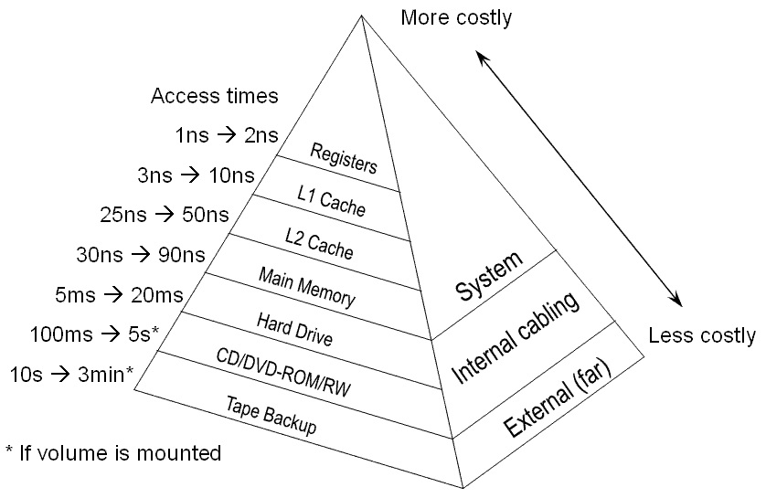
Memory hierarchy

Slide 27
Flat Addressing
Global(shared) | Group | private
Flat addressing is like an one dimension array, is still composed by Main memory, GPU memory, cache, …,etc.
Global segment: main memory, part of L2 cache.
Group segment: GPU local memory.
Private: register, L1 cache.

Slide 28
Flat addressing concept
There are two memory access operation format.
  Take load as example.
ld_group_u32 → segment format
ld_u32 → flat addressing
Flat addressing will depend on the offset to access the corresponding segemt
User must be careful about the offset.

Slide 29
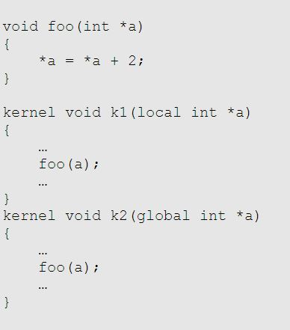
OpenCL generic address space

Slide 30
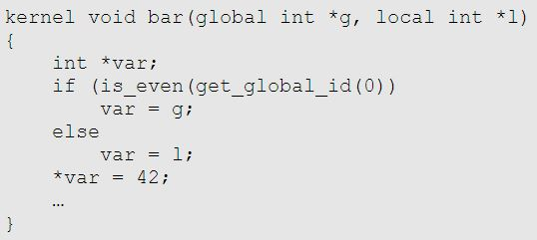
OpenCL generic address space

Slide 31
In assembly view
Can save branch, free from banch prediction fault and cycle stall.
Need hardware to support an powerful instruction, knowing the addressing in which segment.
Ease user to program, but need to know some hardware limit, and maybe pay more effect in optimization.

Slide 32
Cache coherence domains

Slide 33
Cache coherence
Data access to global memory from all agents shall be coherent without the need for explicit cache maintenance.
Only for primary memory type in global segment, not include image access
Read-only image data is required to remain static during the execution of an HSA kernel.

Slide 34
Main idea of cache coherence
Wants hardware to maintain the consistency.
  Programmer no need to maintain cache coherence by themselves.
The traffics of maintaining consistency between CPU cache and GPU cache are too heavy.
But, don’t want to put much more pressure to the vender.
  Only for primary memory type.
  Not for instruction memory.
  Not for the agents that there is not the same memory attribute.

Slide 35
Endianess
HSA system can be implemented as either little or big endian.
  Assumed only one endianess is used
Basic definition:
  Bits [0:7] in byte 0, bits [8:15] in byte 1, …, etc.
  All agents in a system must have the same definition for assigning bit value in multi-bits fields.

Slide 36
Signaling and synchronization

Slide 37
Signaling and synchronization
HSA-compliant platform shall provide signal mechanism.
All operation on signal value should be manipulated by a signal handler.
  Signal and signal handler are opaque.
Agents only can manipulate HSA signals which are within the same user process address space.
  Not support IPC.

Slide 38
Signaling and synchronization
There is no architectural limitation on the number of HSA signals.
HSA signal value must only be manipulated by kernel agent using HSAIL and host CPU using HSA runtime.

Slide 39
Signaling and synchronization
Operation as follows:
  Allocate
  Destroy
  Read
  Wait/wait with duration
  Atomic
Combination with memory order semantics
  Release
  Acquire
  Relax
  Acquire-release

Slide 40
Signaling and synchronization
Signals are generally intended for notification between agents.
  Signal interact with memory model as if it resides in global segment memory.
These definitions are for the doorbell and completion signal using in User Mode Queue and AQL packets.
  More detail in HSA Runtime.

Slide 41
Atomic memory operation

Slide 42
Atomic memory operations
Kernel agent should support standard atomic memory operations
Operation as follows:
  Load from memory
  Store to memory
  Logic operation
  Arithmetic operation
  Exchange
  CAS (compare and swap)

Slide 43
HSA system timestamp

Slide 44
HSA system timestamp
A low overhead mechanism of determining the passing of time.
Only can be read from HSAIL or HSA runtime.
Let GPU ease coherent with CPU at certain time.

Slide 45
HSA system timestamp
Some limit as follows:
  Timestamp value is 64bit integer.
  Should not roll over.
  Increase at a constant rate, regardless of any low power state or any change to operating frequency.
  Increase rate range is [1,400] MHz.
  Uniform view of time (ex. Never appear in decrease value)

Slide 46
Implement of HSA system timestamp
A single timestamp counter peripheral in the system
Many counters distribute in CPUs or GPUs that increment at the same rate and synchronized startup

Slide 47
User mode queuing

Slide 48
User mode queuing
HSA agents can launch job fast by user mode queue directly map on its hardware queue.
The following operations on this queue no need to pass through kernel mode driver anymore.
Shall be characterized as runtime-allocated, user-level, accessible virtual memory of a certain size.

Slide 49
User mode queuing
HSA software should receive memory-based structures to configure the hardware queue to allow for efficient software management of the hardware queues of the agents.
Like a ring buffer with separate memory locations defining write and read state information of that queue.
Packet processor is logically a separate agent from kernel agent, and may have a separate identification as a listener when allocating signals.

Slide 50
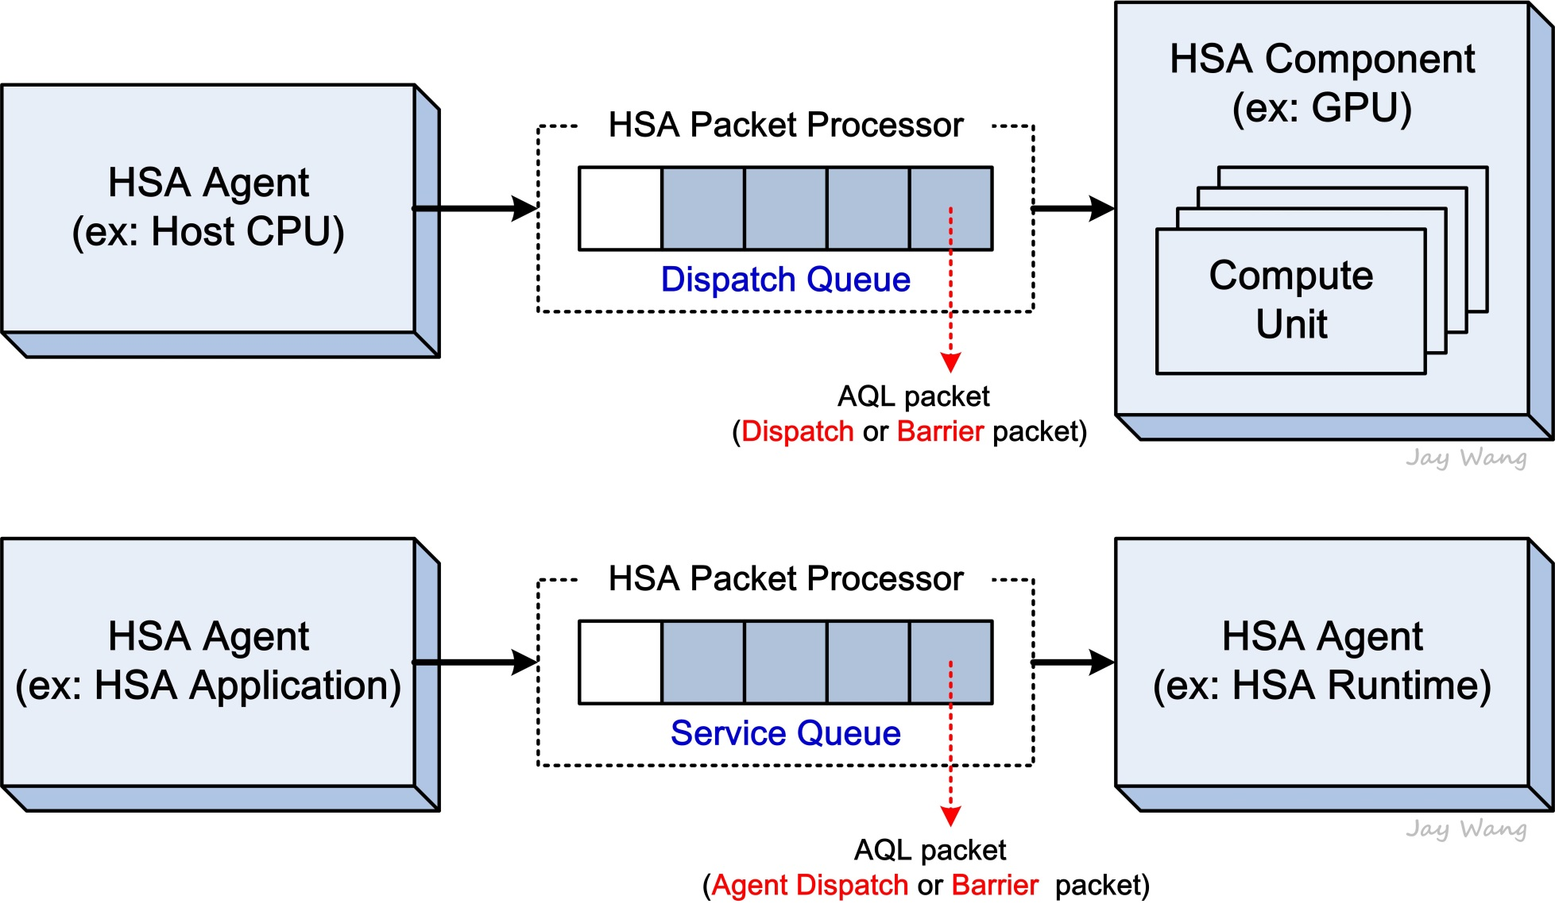
User mode queuing
Two queue types, user mode queue and runtime services dispatch queue
  User mode queue, consumes kernel dispatch packets that are used to specify the information of kernel functions that will be executed on the component
  Runtime service dispatch queue, consumes agent dispatch packets that are used to specify runtime-defined or user registered functions that will be execute on the agent

Slide 51
Runtime services dispatch queue
To invoke a runtime service, or function, the caller passes the arguments and function code in the AGENT_DISPATCH packet
Caller monitor or wait on a completion signal to identify when the “call” has finished.
The return_address referenced within the AGENT_DISPATCH packet will contain the function ‘s return value.
Exact services are defined by the application implementing the runtime services queue.

Slide 52
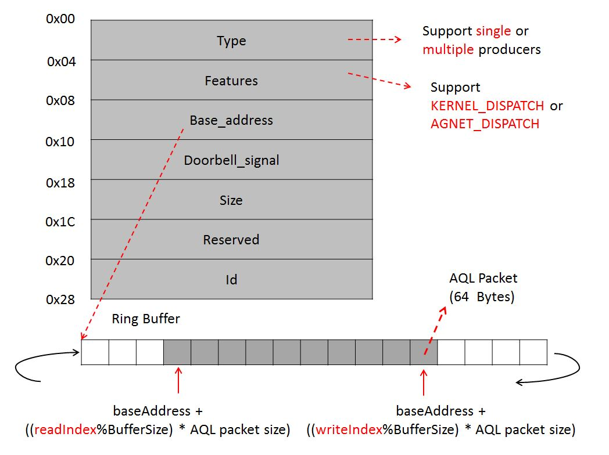
User mode queuing format

Slide 53
Submit a task to a queue
Allocating an AQL packet slot.
Update the AQL packet with the task particulars (note, the format field must remain unchanged)
Assigning the packet to the packet processor
Notifying the packet processor of the packet
More detail in HSA Runtime

Slide 54
Multiple vs. single submitting agents
In order to avoid deadlock when there are multiple agents submit jobs to a full queue
  Check for queue full before incrementing the writeindex and use atomic CAS operation to change writeindex.
  Atomic-add the number of AQL packets to allocate to the writeindex, then check if the queue is full.(difficult to manage)
There will be a dependency on index when multiple agents submit jobs, so use read-modify-write atomic memory operations will be better.

Slide 55
Multiple vs. single submitting agents
Due to the queue mechanism this specification defined, it is good to single agent submits job.
The doorbell can be incremented in order by leveraging writeindex.
Although there are many ways to implement multiple submitters without changing current queue mechanism, it still need more effect on manipulating index.
Because above reasons, this specification recommend using single submitting agent.

Slide 56
Architected Queuing language

Slide 57
Architected Queuing Language
A command interface for the dispatch of agent commands
Defines several different packet types:
  Vendor-specific packet
  Invalid packet
  Kernel dispatch packet
  Agent dispatch packet
  Barrier-AND packet
  Barrier-OR packet

Slide 58
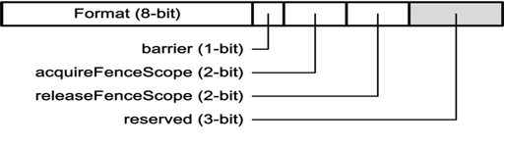
Packet header
AQL_FORMAT:
  0=VENDER_SPECIFIC
  1=INVALID
  2=KERNEL_DISPATCH
  3=BARRIER_AND
  4=AGENT_DISPATCH
  5=BARRIER_OR

Slide 59
Packet header
barrier:
If set, then processing of the packet will only begin when all preceding packets are complete.

Slide 60
Packet header
fence_scope:
Determines the scope and type of the acquire memory fence operation for a packet. It is applied for the packet process flow.

Slide 61
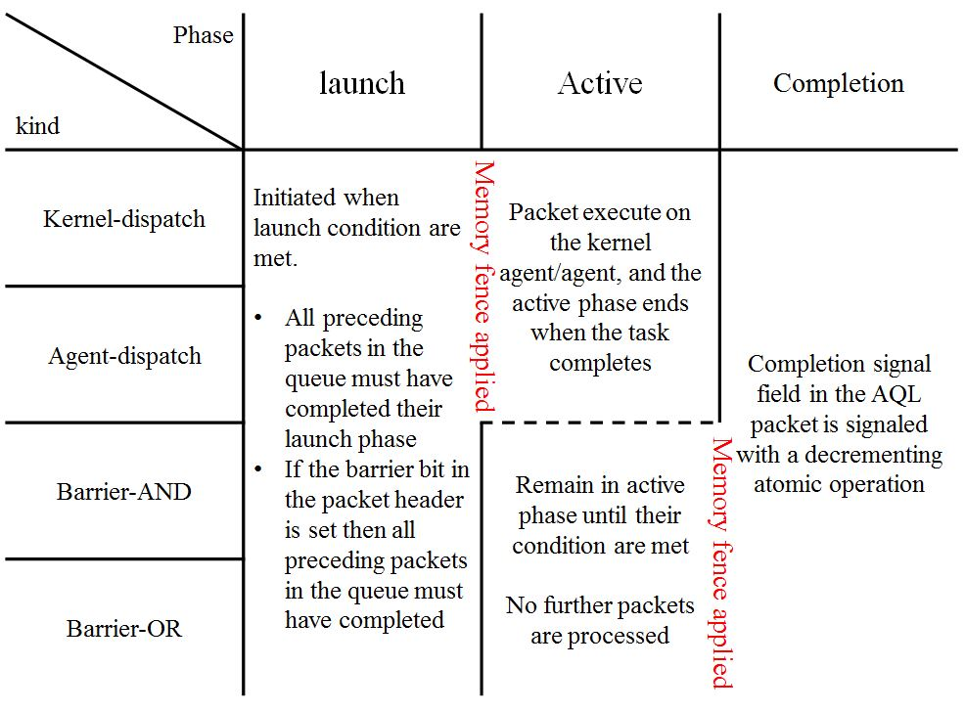
Packet process flow

Slide 62
Error handling
Release fence applied
Queue 1
 |  |  |  | ERROR
 |  |  |  | ERROR
HSA runtime error call back
Queue 2
Packets within the same process still be process.
Queue 3

Slide 63
Vendor-specific packet
Packet header set to VENDOR_SPECIFIC
All other fields of the packet are implementation specific
Let other vendor can design their own product and combine into the HSA system

Slide 64
Invalid packet
Packet header set to INVALID
All other fields of the packet are don’t care
When packet has been completed but process not yet, the packet will change into this state

Slide 65
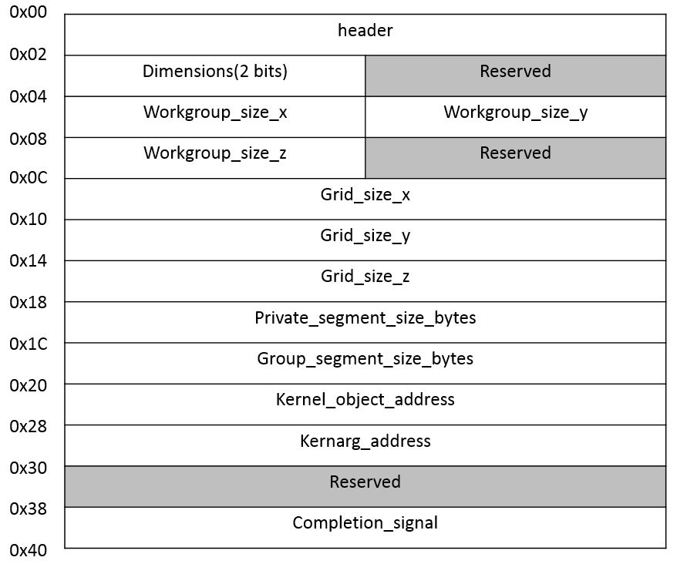
Kernel dispatch packet

Slide 66
Kernel dispatch packet
Kernel dispatch packets contain jobs for the kernel agent and are created by agents
Kernarg minimum aligment granule is 16 bytes. HSAIL may enforce larger aligment granules.
Kernel argument must be allocated by HSA runtime API, and must be visible before kernel dispatch packet is assigned until kernel completes
Minimum required size of kernarg segment is 4kB

Slide 67
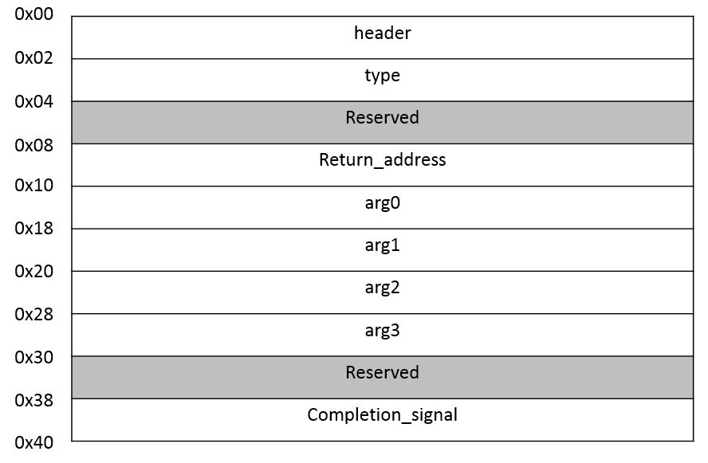
Agent dispatch packet
Function to be performed. Function codes are application defined.
Pointer to location to store the function return value.

Slide 68
Agent dispatch packet
Agent dispatch packets contain jobs for the agent and are created by agents
For using user defined function. Let kernel can call the user defined function for special purpose
Ex. GPU call the function in CPU to do something for it.

Slide 69
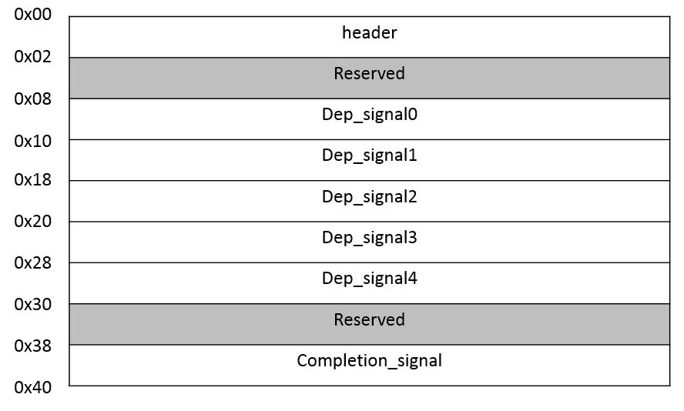
Barrier-AND packet/Barrier-OR packet
Handles for dependent signaling objects

Slide 70
Barrier-AND packet/Barrier-OR packet
Barrier-AND packets can insert by agents to delay processing subsequent packets. All queues support barrier-AND packets
The execution phase for the barrier-AND packet completes when the following condition is met:
  All dependent signals have been observed with value 0 after launched(no need to be 0 at the same time)
  Completion_signal will be signaled with an atomic decrementing operation
  Packet processor should monitor all the dependent signals continuously
  No need to see all the intermediate values on the signals
  In some condition, NULL = 0(Barrier-OR think NULL as non-zero)

Slide 71
Barrier-AND packet/Barrier-OR packet(圖例)
Queue 1
Queue 2
 |  |  |  |  | Barrier
Can’t launch until barrier finish
Queue 3

Slide 72
Agent scheduling
Provide ability to schedule tasks in queue or any from additional pool of non-HSA tasks
HSA programming model encourages the use of multiple queues per application to enable complex sequences of tasks to be scheduled
To ensure consistent performance across HSA-complicant systems, it is recommended that when using multiple queues the scheduling algorithm will schedule efficiently across them and minimize the overhead for managing multiple queues

Slide 73
Agent scheduling
Agent scheduling must have the following characteristics:
  Packet submission to any queue connected to the agent
  Agent scheduling must be able to monitor the AQL packet being active on each queue
  Monitoring includes any combination of supported AQL packets and their dependencies
  Avoid deadlock
  Monitoring can’t occupy any execution resources
  Scheduling should reply events in a responable time
  Full utilization, more efficient
  Kinds of barrier packets are not allowed to occupy agent/kernel agent execution resources

Slide 74
Kernel Agent context switching
Scheduling of multiple HSA contexts to a device with appropriate prioritization, throughput, and latency constraints
Scheduling of both HSA and non-HSA tasks on devices that can support both task types
Stopping any currently running wavrfronts → saving the current context state to memory → restoring context state of another context from memory →starting execution at the state left when it was stopped previously

Slide 75
Kernel Agent context switching
Three priorities pf context switch
  Switch → Context switch not required to occur immediately. Hardware may continue to issue work-items, and context switch happened at a point where the size of HSA context can be reduced
  Preempt → Context switch is required as soon as possible. System software should know how long the hardware guaranteed context switch latency
  Terminate and context reset → HSA context should be terminated as fast as possible. There is no requirement to preserve state. The kernel agent is available for scheduling another context afterwords

Slide 76
Implement through hard preemption
Context switch mechanism shall provide “preempt” and forced exit of currently running wavefronts
On preemption, kernel agent shall save all state to memory that would be required to restart the preempted context again
The preemption mechanism must not wait for events that have undetermined latency

Slide 77
IEEE754-2008 floating point exceptions
IEEE754-2008 exceptions:
  INVALID_OPERATION
  DIVIDE_BY_ZERO
  OVERFLOW
  UNDERFLOW
  INEXACT (significant bit lose, destination register can’t hold)

Slide 78
IEEE754-2008 floating point exceptions
Two mechanism
  DETECT → kernel agent must maintain a status bit for each of the DETECT-enabled arithmetic exceptions for each work group and initiated by 0 (support HSAIL instructions that can read or write the exception status field while the kernel is running)
  BREAK → kernel agent must stop the excepting wavefront’s execution of the HSAIL instruction stream precisely at the instruction which generated the exception(other continue to end, not launch will stop)

Slide 79
IEEE754-2008 floating point exceptions
The kernel agent signals the runtime, which invokes an exception handler defined in the HSA runtime.
Reported information must include:
  Exception code
  PASID (process address space ID)
  Queue id
  Packet id
  Precise instruction counter that caused the exception

Slide 80
IEEE754-2008 floating point exceptions
Some possible uses for the runtime exception handler are:
  Invoking a debugger which allows the developer to determine which fuction caused the exception and inspect the surrounding memory and register state
  Logging the exception to a file
  Killing the process
The enabling of the DETECT and BREAK exception polices is controlled through the HSAIL finalization
It is recommended that performance with DETECT policy be close to native code performance since this is a commonly-used exeception policy

Slide 81
Kernel agent hardware debug
At minimum, instruction breakpoints shall be supported.
Memory breakpoints, memory faults, conditional breakpoints is optional
When hitting break point, retire all pending writes to memory, stop wavefront, provide information about breakpoint condition, affected PASID, user level queue, instruction, and wvaefront/group ID
System software shall provide appropriate resident memory to allow kernel agent write out state information

Slide 82
HSA Platform Topology Discovery
The HSA System Architecture requirements cover a wide range of systems with variety of elements
In order to leverage the available elements to their fullest, application and system software need a way to discovery and chatacterize following:
  The available HSA agents
  Their topological relation to each other
  Other relevant system resource e.g. Memory, caches, I/O, and host agents

Slide 83
HSA Platform Topology Discovery
Application can discover these through various runtime APIs and software may leverage these parameters for optimizing performance on specific platform
The relationships of kernel agent to each other can be established by the system software parsing the data and communicated to the HSA runtime and HSA applications
Depending on the platform, the data should be group hierarchically to correspond to components such as Agent, memory, compute properties, caches, and I/O

Slide 84
HSA Platform Topology Discovery
The data are associated with a node ID, forming a per-node element list which references the elements contained at relative offsets within that list
Node ID should be 0-based, 0 ID also representing the primary elements of the system(Whether the oder of number should met with other specification(e.g. ACPI) is out of the scope of the System Architecture and outlined in the Runtime API specification)
The node grouping of physical memory follows NUMA principles to leverage memory locality in software when multiple physical memory blocks are available in the system and agents have a different “access cost” to that memory
Notes:
ACPI - Advance Configuration and Power Interface Intel.

Slide 85
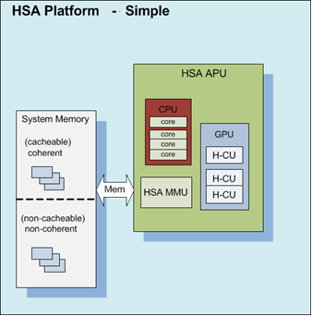
HSA Platform Topology Discovery
this figure is an example for a structurally simpler platform with only one “node”, containing HSA agent and memory resources

Slide 86
Topology requirement
Topology should not change during the application enumeration process itself, but some advance system that support “docking”, the system must provide properties to detect ephermeral vs persistent components and use notification that allow them to re-enurmerate the updated topology
System software and runtime may provide mechanisms to the application to notify it about topology changes that may be caused by platform and system events

Slide 87
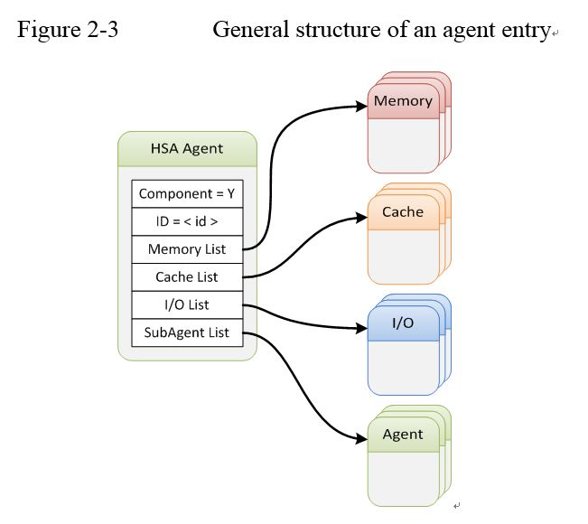
Agent & kernel entry

Slide 88
HSA Agent Entry
At minimum, the following HSA agent parameters would be made available via APIs:
  Kernel agent & agent indicator
  Type(throughput/vector, latency/scalar, DSP)
  Node ID
  Element ID
    Used to individually identify the agent on that platform
  Maximum number of Compute Units
  Maximum work-item dimensions
  Maximum work-item sizes
  Machine model
  Endianness
  Queue size

Slide 89
HSA Agent Entry
Other optional parameters:
  Maximum Clock Frequency in MHz (0 if not exposed on a platform)
  Friendly name (equivalent to “device name” in OpenCL™)
  Floating point capabilities

Slide 90
HSA memory entry
The HSA Memory Entry describes the physical properties of a block memory in the system with identifiable characteristics that can be accessedby the HSA agents
The following HSA memory parameters of each physically distinguishable memory block would be made available to system software and potentially made available to applications via APIs
  Node ID
  Element ID
  Virtual base address
  Physical memory size in bytes

Slide 91
HSA memory entry
Optional HSA memory parameters
  Memory interleave
  Number of memory channels
  Memory width per memory channel
  Maximum memory throughput in MByte/s
  Minimum memory access latency in picoseconds

Slide 92
HSA cache entry
At minimum, the following HSA memory parameters would be made available via APIs
  Node ID
  Element ID
  Cache type, e.g. read-only or read/write cache
  Total size of cache in kilobytes
  Cache line size in bytes
  Cache level (1, 2, 3, …)
  Associativity (0 = reserved, 1= direct mapped, 2=0xFE associativity, 0xFFh=fully associative)
  Exclusive/inclusive to lower level caches
  Agent association if cache is shared between agents (identified via nodemask)

Slide 93
HSA cache entry
Optional HSA memory parameters
  Maximum latency (in picoseconds)

Slide 94
    Topology Structure Example
This figure outlines an illustrative example of how the information can be used to express specific system topology, using 71 page block diagram as the basis

